Slide 1
Random Quote Generator
Brilliant Quotes
Vikram Singh
2110992262
G19

Slide 2
Introduction
In a world filled with constant streams of information and a myriad of opinions, the Random Quote Generator stands as an oasis of wisdom, inspiration, and thought-provoking words. This simple web application is designed to deliver a moment of reflection and inspiration by providing you with a random, handpicked quote from a collection of timeless wisdom.
Have you ever craved a dash of motivation, a spark of creativity, or simply a moment of contemplation? The Random Quote Generator is your answer. With a click of a button, it serves up a fresh dose of wisdom, reminding you of the wisdom and insight that can be found in the words of great thinkers, leaders, and artists.
This project combines the power of HTML, CSS, and JavaScript to create a visually pleasing and user-friendly experience. It not only offers a beautiful interface to display quotes but also showcases the potential of programming to deliver meaningful content to users.
Whether you're looking for a daily source of inspiration, a tool to kickstart your creative process, or simply a moment of reflection, the Random Quote Generator is your virtual companion. Let the wisdom of the ages guide and inspire you one quote at a time.
Dive into the world of quotes, discover new perspectives, and let the Random Quote Generator be your portal to a world of timeless wisdom.
Click the "New Quote" button and let the journey begin!

Slide 3
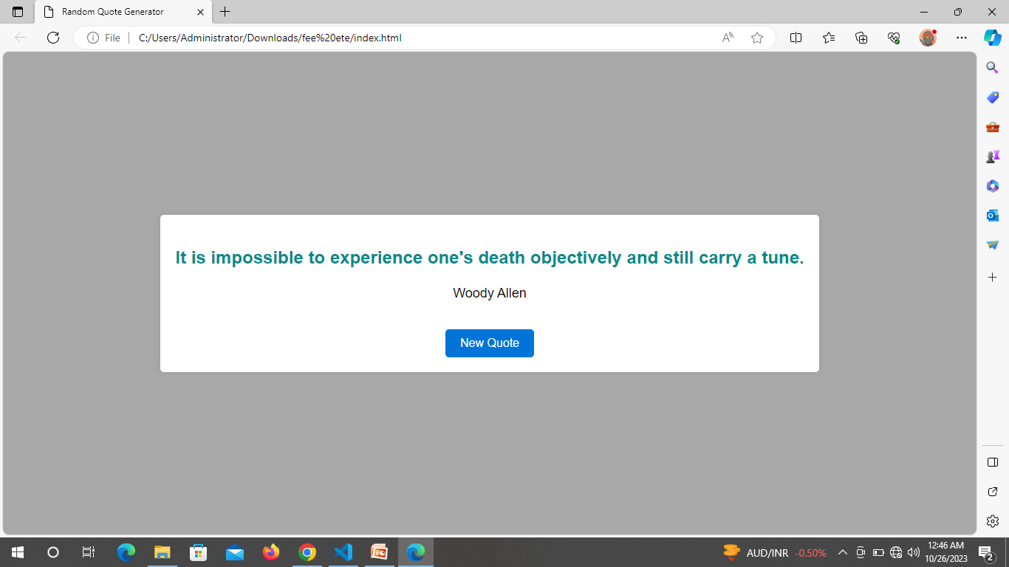

Slide 4
User Interface and Design
User Interface and Design:
The Random Quote Generator boasts a clean and elegant user interface, carefully designed to enhance your experience as you explore the world of wisdom and inspiration. Our focus on simplicity and user-friendliness ensures that you can effortlessly engage with the content and find moments of enlightenment. Here's a breakdown of the UI and design elements:
Thoughtful Typography:
The use of a legible and modern font ensures that the text is easy to read and visually pleasing. Quotes are presented in a prominent, large font size, making them the centerpiece of the interface.
Inspiring Quotes:
The heart of the application, the "Quote" section, is designed to showcase the wisdom contained in each quote. The text is presented on a clean white background, allowing it to stand out and captivate your attention.
Author Attribution:
Beneath each quote, you'll find the name of the author. This attribution is displayed in a slightly smaller, elegant font, emphasizing the words themselves while giving credit to their source.
Aesthetically Pleasing Colors:
The color scheme is carefully chosen to promote a sense of calm and focus. A neutral background shade complements the vibrant blue of the "New Quote" button, creating an eye-catching contrast.
.
In essence, the Random Quote Generator's user interface and design were crafted with the user's experience in mind. It is a testament to the power of simple, elegant design in delivering wisdom and inspiration directly to your digital doorstep.

Slide 5
Functional Features
Responsive Design:
The user interface is designed to adapt to various screen sizes and devices. Whether you're using a desktop computer, tablet, or smart phone, the Random Quote Generator will provide a seamless and consistent experience.
Engaging Interaction:
The "New Quote" button, designed with a pleasant shade of blue, invites you to discover fresh insights with every click. Hovering over the button highlights it, indicating its interactive nature.
Minimalistic Layout:
The layout is intentionally minimalistic, with a clean and uncluttered design. This focuses your attention on the quotes themselves, enhancing the overall experience.
Subtle Shadowing:
Subtle box shadowing creates a sense of depth, giving the interface a polished look and making the content appear to float above the page.
Mobile-Friendly:
The interface is optimized for mobile devices, ensuring that you can enjoy the Random Quote Generator on the go, making it a perfect companion for moments of reflection anytime, anywhere Movie Filtering: Our movie app boasts advanced filtering options, enabling users to explore films by genre and language. A user-friendly search bar simplifies the process of finding specific titles.

Slide 6
Technology Stack
Here's a breakdown of the key technologies and their functions:
HTML (HyperText Markup Language):
Function: HTML is used to structure the content of your web page, defining the layout and elements like headers, paragraphs, buttons, and forms.
CSS (Cascading Style Sheets):
Function: CSS is responsible for the project's visual styling. It defines the colors, fonts, layout, and overall presentation of the content to make it visually appealing and user-friendly.
JavaScript:
Function: JavaScript is a crucial component for the interactivity of your Random Quote Generator. It enables dynamic updates, such as changing quotes, handling user interactions, and making the application responsive.
Random Quote Data (Array of Objects):
Function: An array of objects is used to store a collection of quotes and their respective authors. JavaScript functions access and select a random quote from this data when the "New Quote" button is clicked.

Slide 7
API Integration (for fetching external data):
Function: You can integrate with external APIs that provide quotes or allow users to share their favorite quotes on social media platforms. This expands the functionality and engagement of your application.
Data Analytics (using tools like Google Analytics or custom solutions):
Function: Data analytics tools help you understand user behavior, preferences, and engagement patterns. This data can inform future improvements to the project.
Responsive Web Design (using media queries):
Function: Media queries in CSS enable your project to be responsive, adapting to various screen sizes and orientations, ensuring a consistent and user-friendly experience on different devices.
Terms of Service and Privacy Policy Pages:
Function: These pages outline the rules and privacy policies governing the usage of the platform, ensuring transparency and legal compliance.

Slide 8
Event Listeners:
Function: JavaScript event listeners are used to respond to user interactions. For example, when the "New Quote" button is clicked, it triggers a function to generate and display a new random quote.
Themes and Customization (CSS Variables):
Function: CSS variables can be used to enable theme customization. Users can choose from predefined themes, and the CSS variables adjust the color scheme and styles accordingly.
By employing these technologies and functions, your Random Quote Generator can offer a secure, interactive, and visually appealing experience to users, catering to their preferences and needs.

Slide 9
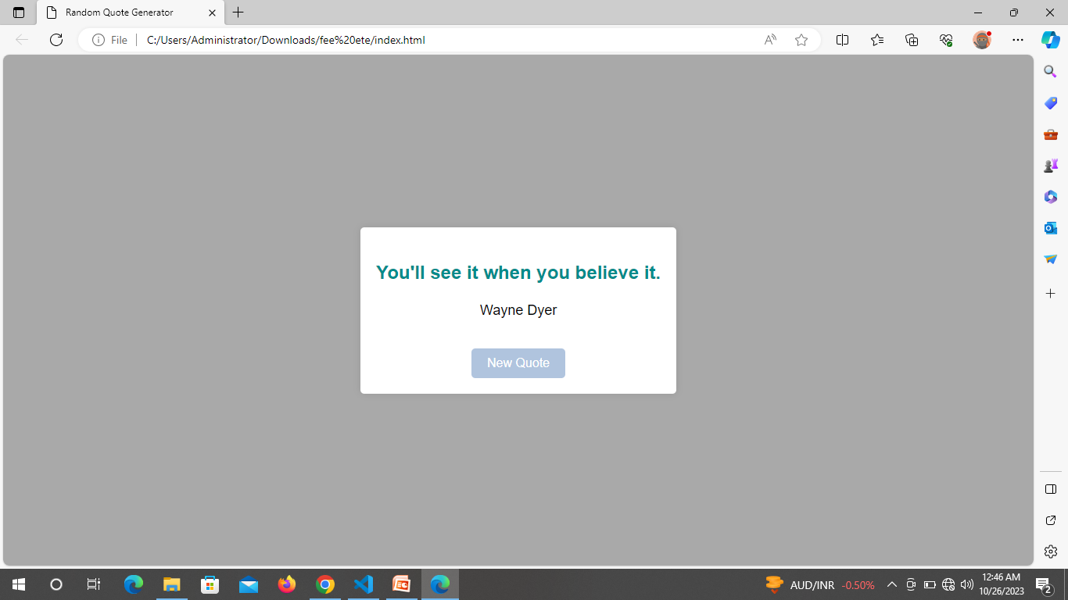

Slide 10
Challenges
The journey of developing our website was not without its challenges. These obstacles, while demanding, represented opportunities for growth and learning. I encountered a range of technical complexities, each requiring inventive solutions:
API Integration: One significant challenge was integrating multiple APIs seamlessly. Coordinating data flow and maintaining synchronization across different platforms required meticulous planning and coding expertise.
App Performance Optimization: As the app's features expanded, optimizing its performance to deliver a responsive and fluid user experience became a complex task. Balancing functionality with speed and efficiency was a constant consideration.

